Slide 1
Naïve Bayes for text classification
By Dr. Ali Saeed

Slide 2
Outline
Bayes Rule
Working of Naive Bayes Classifier
Example Naive Bayes Classifier
How Naive Bayes Classifier can be used for text classification
How Naive Bayes Classifier is used for Multi-Class text classification

Slide 3
Bayes’ Rule Overview
Now let’s learn about:
Bayes rule & how to turn this into a classifier
  E.g. How to decide if a patient is ill or healthy, based on
    A probabilistic model of the observed data
    Prior knowledge

Slide 4
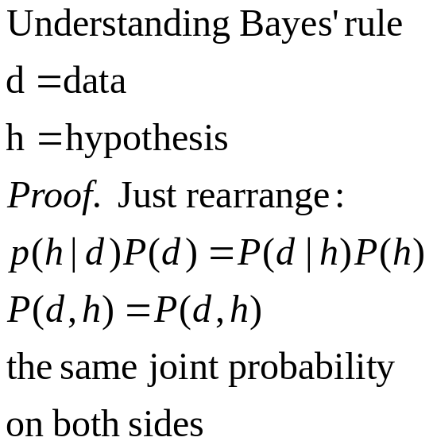
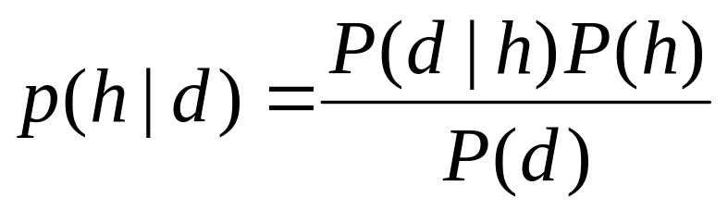
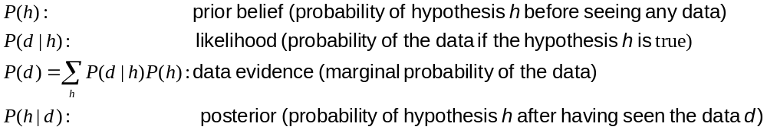
Bayes’ Rule
Who is who in Bayes’ rule

Slide 5
Why Naïve Bayes is Naïve?
Naïve Bayesian classification is called naïve because it assumes class conditional independence.
In other words the effect of an attribute value on a given class is independent of the values of the other attributes.
This assumption is made to reduce computational costs, and therefore it is considered naïve.

Slide 6
Why Naïve Bayes is Naïve?
Naïve Bayes is a supervised learning approach
Naïve Bayes is a classification approach
It requires labeled data for training and testing
We can not train Naïve Bayes on raw data (Un-labeled data)
Feature Extraction is manual

Slide 7
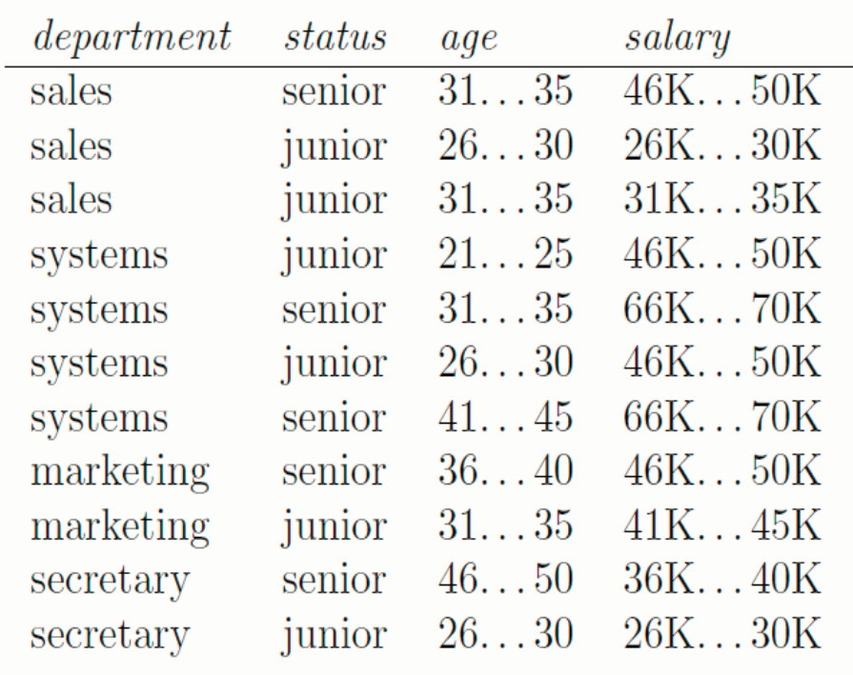
Train a naïve Bayesian classifier as the status attribute is the class label and all the remaining attributes are regarded as input. Once you have your naïve Bayesian classifier, test the following unseen instances:
1. (sales,31…35, 66K…70K).

Slide 8
We first estimate prior probabilities for the “status” class labels. P (senior) = 5/11and P (junior) =6/11.
P (department | status)
Class | sales | systems | marketing | secretary
senior | 1/5 | 2/5 | 1/5 | 1/5
junior | 2/6=1/3 | 2/6=1/3 | 1/6 | 1/6

Slide 9
P (age | status)
P (salary | status)
Class | 21…25 | 26…30 | 31…35 | 36…40 | 41…45 | 46…50
senior | 0/5=0 | 0/5=0 | 2/5 | 1/5 | 1/5 | 1/5
junior | 1/6 | 3/6=1/2 | 2/6=1/3 | 0/6=0 | 0/6=0 | 0/6=0
Class | 26K-30K | 31K-35K | 36K-40K | 41K-45K | 46K-50K | 66K-70K
senior | 0/5=0 | 0/5=0 | 1/5 | 0/5=0 | 2/5 | 2/5
junior | 2/6 = 1/3 | 1/6 | 0/6 = 0 | 1/6 | 2/6 = 1/3 | 0/6

Slide 10
(For the test instance b) sale, 31…35, 66K 70K),
P (senior|b) = P (senior) P (sale|senior) P (31…35|senior) P (66K…70K|senior)
= 5/11*1/5*2/5*2/5
P (junior|b) = P (junior) P (sale|junior) P (31…35|junior) P (66K…70K|junior)
= 6/11*1/3*1/3*0/3
The label for this instance (person) is “senior” since P (junior|a) < P (senior|a)

Slide 11
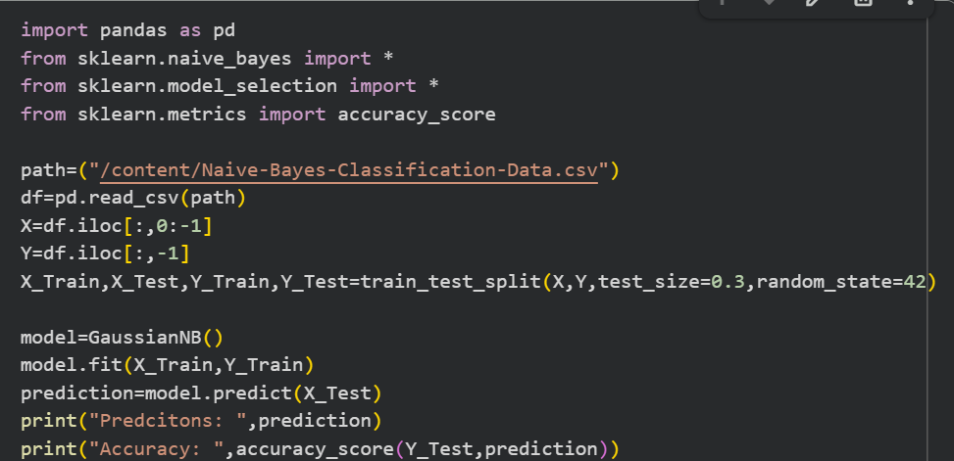
Numeric Dataset Apply Naive Base
Heart Disease Predictions apply On Numeric
GaussainNB Continuous numeric data (age, salary, BP)

Slide 12
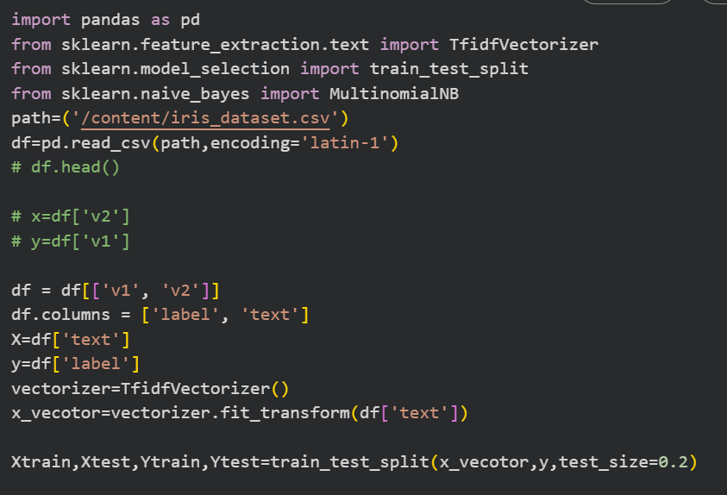
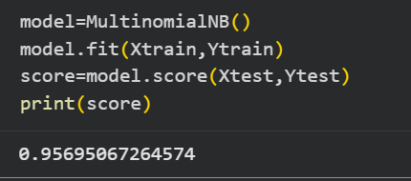
MultinomialNB
Text / counts (word frequency)

Slide 13
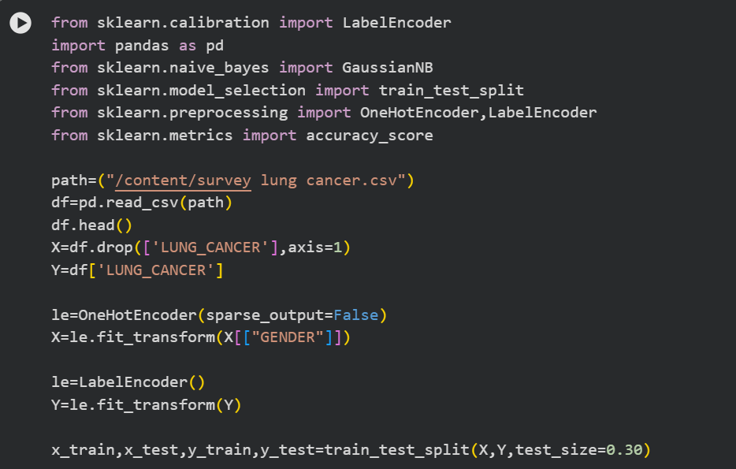
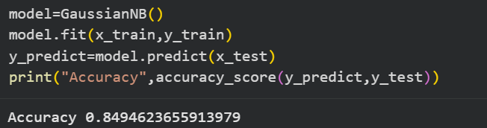
Lung Cancer GussainNB

